Slide 1
Analysis of the Neighborhoods in Manhattan
Ting Li
2019-4-16

Slide 2
Introduction
1. Manhattan neighborhoods
2. Client requirements
Restaurants
Hotels
Neighborhoods

Slide 3
Data
1. Manhattan Neighborhood data
https://geo.nyu.edu/catalog/nyu_2451_34572)
2. Foursquare API

Slide 4
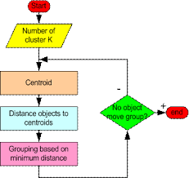
K means clustering
Minimize the intra-cluster distances and maximize the inter-cluster distances
The items within the cluster is very similar to each other and the items from different clusters will be very different
* people.revoledu.com

Slide 5
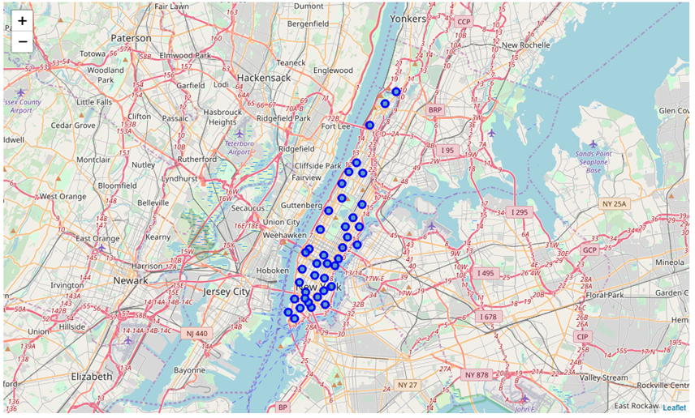
Neighborhood analysis

Slide 6
Data process
Neighborhood data with all the surrounding venue information (500 radius, limit 100)
Neighborhoods that has at least one hotel
Top 10 venue category in each Neighborhood
K-means clustering with 6 clusters

Slide 7
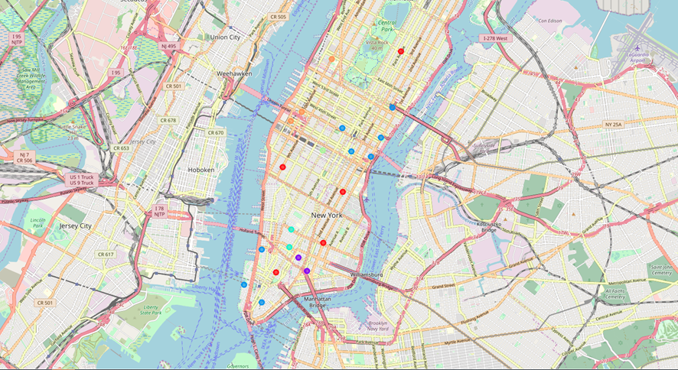
Neighborhood analysis

Slide 8
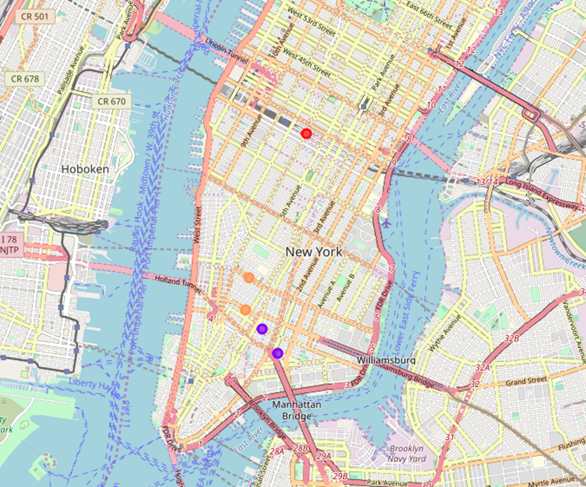
Neighborhood analysis

Slide 9
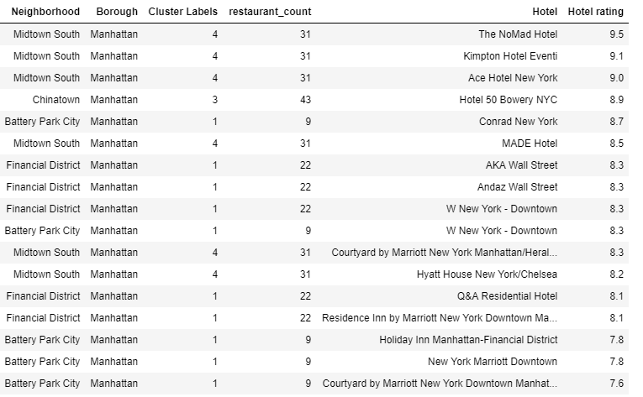
Results

Slide 10
Discussion
Take into consideration of the quality/rating of each restaurant.
Consider other perspectives in these neighborhoods (such as demographic data of the people living in the neighborhood) when we do the clustering analysis.

Slide 11
Conclusion
In this project, we analyzed the neighborhood information using the Manhattan neighborhood data and the Foursquare API location data and recommended the two neighborhoods with two hotels for our client Lily to stay for her trip to Manhattan next month.
As the results, ‘NoMad Hotel’ with a rating of 9.5 in neighborhood ‘Midtown South’’ and ‘Hotel 50 Bowery NYC’ with a rating of 8.9 in the neighborhood ‘Chinatown’ will be our recommendation to the client

Slide 12
Q & A
Thank you!~

